Slide 1
Non-Small-Cell Lung Cancer Prediction& Classification
Nouran Moussa
Eman Elhalawany
1
Sara Hamouda
Nourhan Elhalawany

Slide 2
Agenda
01
04
02
05
03
06
Introduction
Prediction (ML models)
Lung Cancer
Classification (DL VGG16)
Datasets
Conclusion& Future Work
2

Slide 3
01
Introduction
3

Slide 4
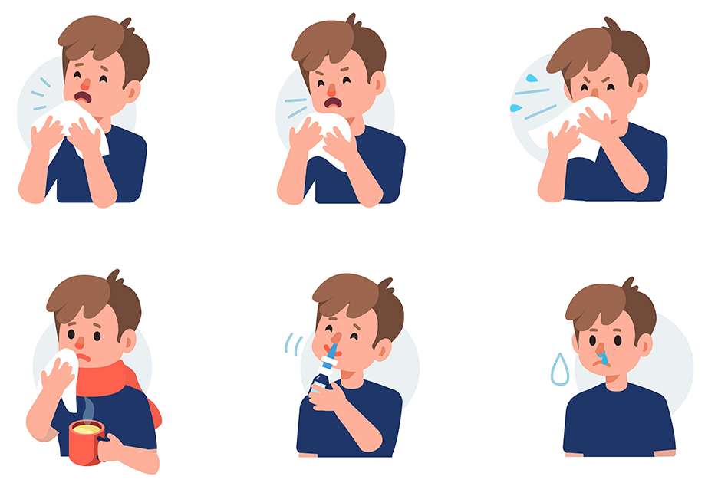
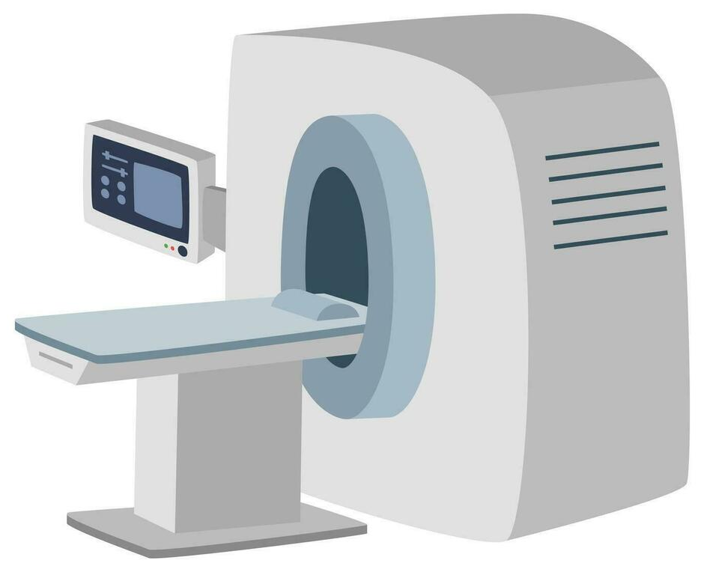
Introduction
KNN
Random Forest
VGG16
SVM
Logistic Regression
1
2
4

Slide 5
02
Lung Cancer
5

Slide 6
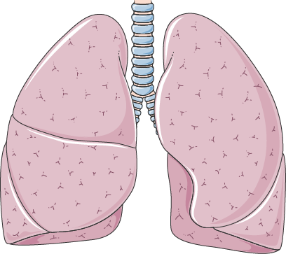
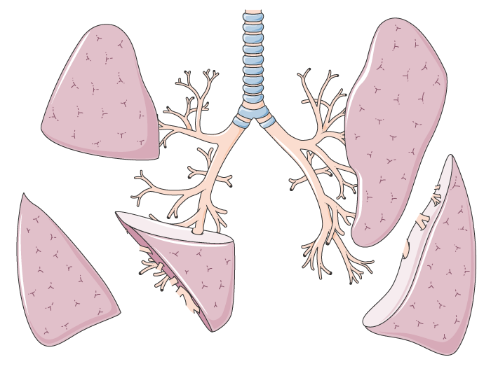
Lung Cancer
Right Lung
Left Lung
Upper Lobe
Upper Lobe
Middle Lobe
Lower Lobe
Lower Lobe
6

Slide 7
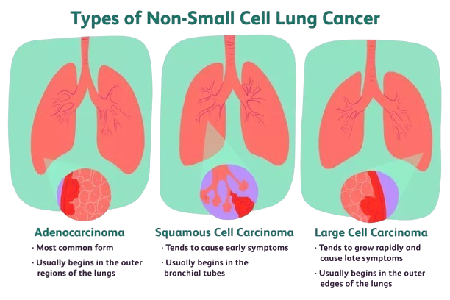
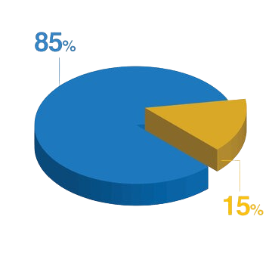
Lung Cancer (cont.)
Non-Small-Cell Lung Cancer (NSCLC)
Small-Cell Lung Cancer (SCLC)
Adenocarcinoma
Squamous Cell Carcinoma
Large Cell Carcinoma
Less common
Highly aggressive
7

Slide 8
03
Datasets
8

Slide 9
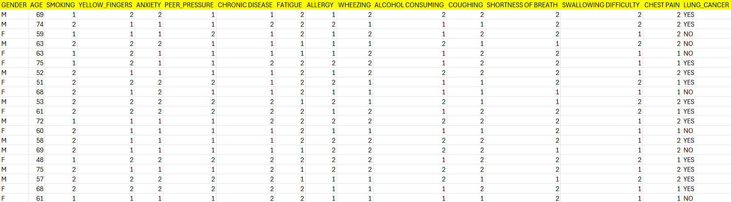
Dataset #1 (initial screening)
Common psychological symptoms
Contribute to the body defense mechanism
Part of the respiratory tree is narrowed or obstructed
Lungs sensitive to histamines and sulphites
Part of the respiratory tree is narrowed or obstructed
9 out of 10 of all lung cancer deaths
Main symptom (over 3 weeks)
Main symptom
Hypoxemia
Dysphagia
309 entry
9

Slide 10
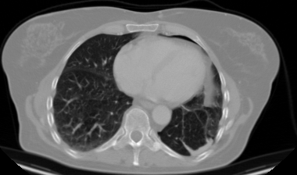
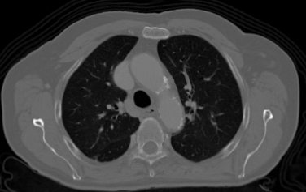
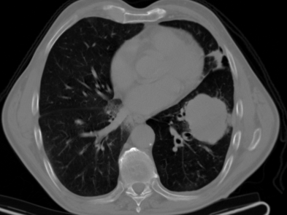
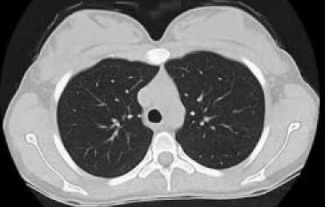
Dataset #2 (advanced screening)
Adenocarcinoma
Squamous Cell Carcinoma
1000 entry
Large Cell Carcinoma
Normal Lung
10

Slide 11

Project Scope
Go home
Initial Screening
(prediction through ML)
-ve
+ve
Advanced Screening
(classification through DL)
11

Slide 12
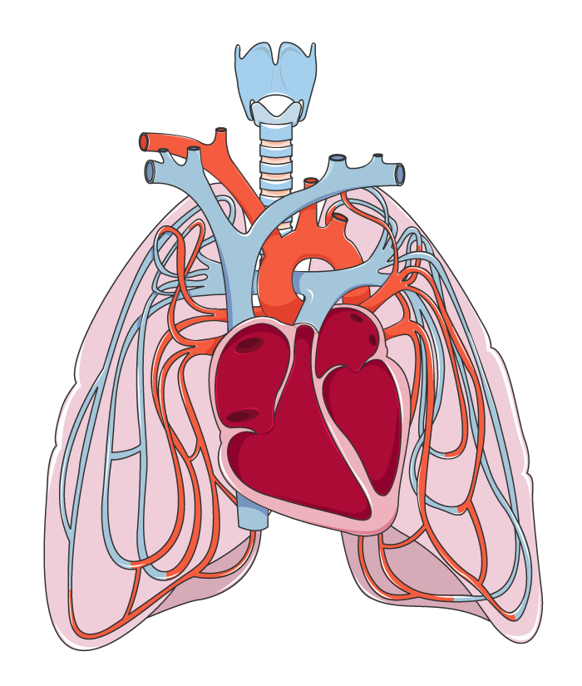
04
Lung Cancer Prediction
12

Slide 13
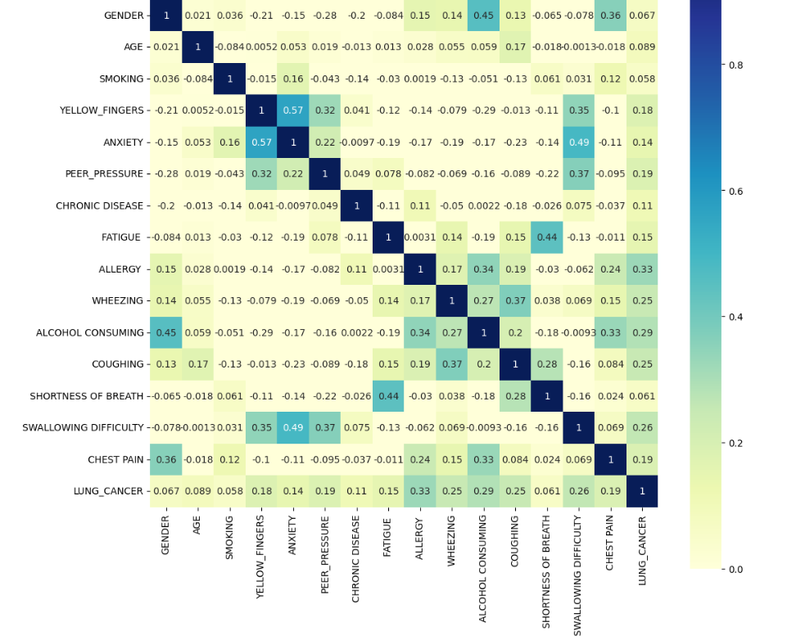
Exploratory Data Analysis (EDA)
13

Slide 14
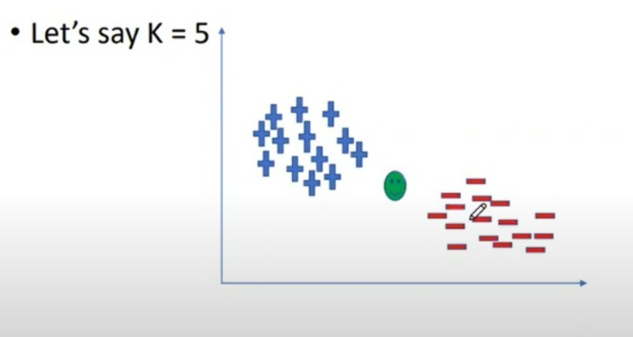
K-nearest neighbors Algorithm (KNN)
14

Slide 15
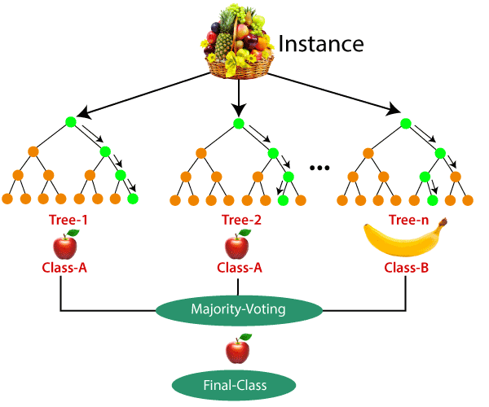
Random Forest Algorithm
15

Slide 16
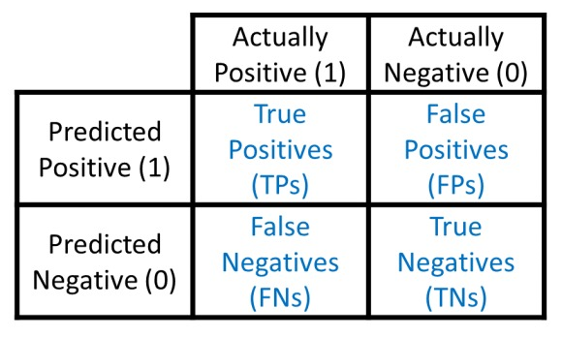
Model Evaluation
Confusion matrix
16

Slide 17
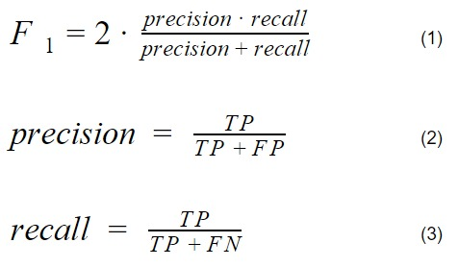
Model Evaluation (cont.)
Classification report
17

Slide 18
Support Vector Machine
How it works?
Hyperplane and Decision Boundary:
- Divides the data points of different classes.
- Finding a hyperplane that best separates the classes that maximizes the margin between the two classes.
- The distance between the hyperplane and the closest data points from either class, known as support vectors.
- These points are critical in defining the position and orientation of the hyperplane.
- SVM algorithm focuses on these points to find the optimal hyperplane.
- SVM aims to maximize this margin, ensuring that the data points are as far from the decision boundary.
18

Slide 19
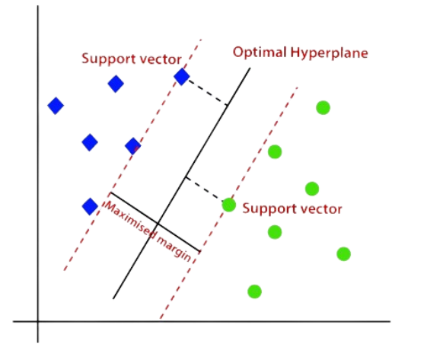
Support Vector Machine (cont.)
19

Slide 20

Logistic Regression
How it works?
Logistic Function (Sigmoid Function):
- Logistic regression uses the logistic function to model the probability of a binary outcome, maps any real-valued number into a value between 0 and 1.
20

Slide 21
Logistic Regression (cont.)
How it works?
Linear Combination:
- Computes a linear combination of input features (like linear regression).
Prediction:
- The output of the sigmoid function σ(z) gives a probability value between 0 and 1.
- This value represents the probability of the data point belonging to the positive class (often labeled as 1).
21

Slide 22
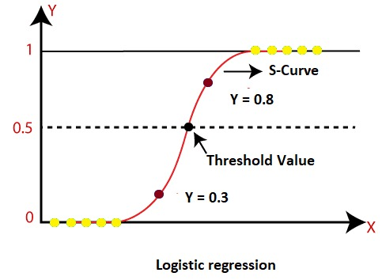
Logistic Regression (cont.)
22

Slide 23
Logistic Regression (cont.)
How it works?
Cost Function:
- Logistic regression uses a cost function known as the log-loss or binary cross-entropy.
- The cost function measures how well the model's predictions align with the actual labels.
Training the Model:
- Training involves finding the coefficients 𝛽0,𝛽1…that minimize the cost function.
- This is typically done using optimization techniques like Gradient Descent.
23

Slide 24
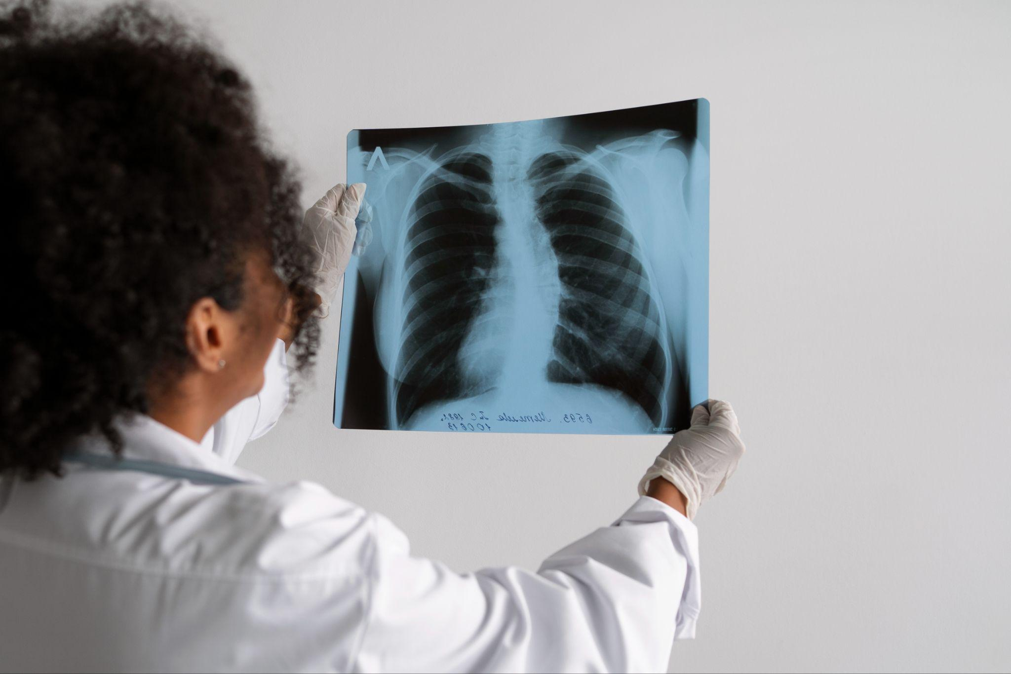
NSCLC Classification
05
23

Slide 25
Classification
Image Augmentation:
- Applies random transformations (rotation, width/height shifts, shearing, zooming, flipping) to the training data.
- Helps to artificially increase the size of the training dataset by generating new, varied images.
- Improves generalization, reduces overfitting, and allows the model to learn more robust features from the input data.
- No augmentation is applied to validation/test datasets, to remain as true representations of real-world data for accurate performance evaluation.
24

Slide 26
Classification (cont.)
Data Generators:
- Generates batches of augmented training data from the specified directory, resizing them to 224x224 pixels, which matches the input size expected by the VGG16 model.
- More memory efficient than loading the entire dataset into memory.
25

Slide 27
Classification (cont.)
Squeeze-and-Excitation Block
- The SE Block is like a smart filter that helps a neural network focus on the most important parts of an image.
How it works?
Squeeze:
- If the image has a lot of different channels (or features), the SE Block first summarizes the information in each channel by averaging out the details across the entire image.
- This step gives a single value for each channel, which tells how important that channel.
26

Slide 28
Classification (cont.)
Squeeze-and-Excitation Block
How it works?
Excitation:
- Next, the SE Block uses a small, simple decision-making process (a tiny neural network) to decide how much attention each channel should get.
- It assigns a weight to each channel; some channels get more weight while others get less.
27

Slide 29
Classification (cont.)
Residual Block
- Fundamental component of ResNet (Residual Networks).
- Designed to make training deep neural networks more effective by addressing the problem of vanishing gradients (the values used to update the weights in a neural network during training) become very small.
- The key idea of the residual block is the introduction of skip connections, allow the network to bypass one or more layers, making it easier for the gradient to pass through the network during the training process.
28

Slide 30
Classification (cont.)
Residual Block
How it works?
- Convolutional Layers: typically contains two or more convolutional layers that process the input data.
- Skip Connection: Instead of just passing the data through the convolutional layers, a skip connection is added that allows the input to be added directly to the output of these layers.
- Final Output: The final output of the block is the sum of the original input and the output of the convolutional layers.
30

Slide 31
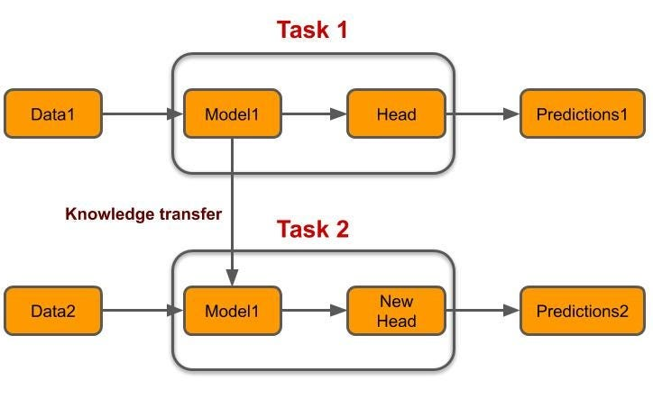
Transfer Learning
29

Slide 32
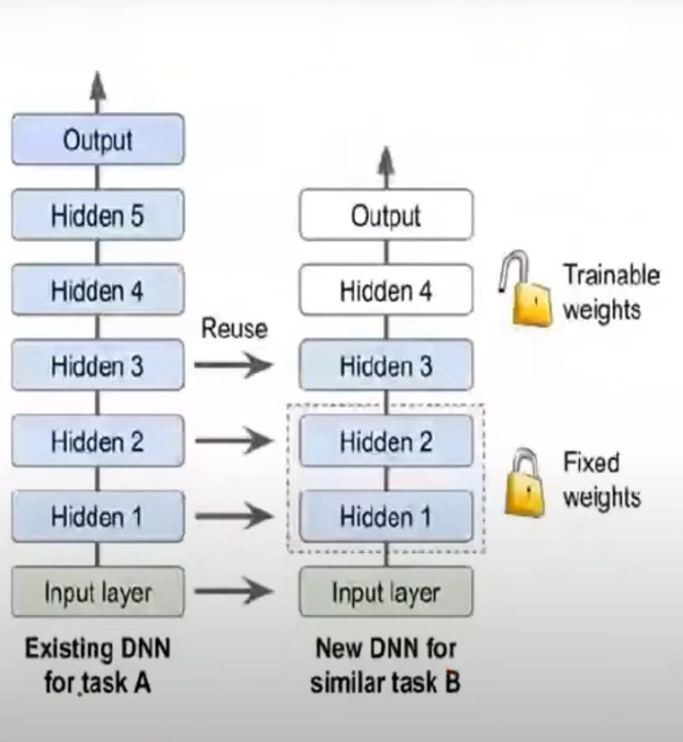
Transfer Learning (cont.)
30

Slide 33
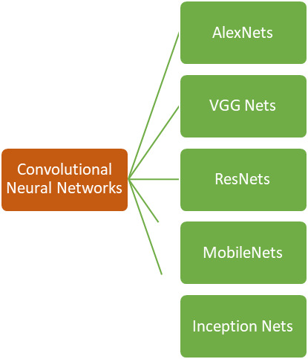
Transfer Learning (cont.)
31

Slide 34
VGG-16
What is VGG16?
- Convolutional neural network (CNN) model that’s used for image recognition.
- Only has layers that have weights, as opposed to relying on a large number of hyper parameters.
- One of the best vision model architectures.
32

Slide 35
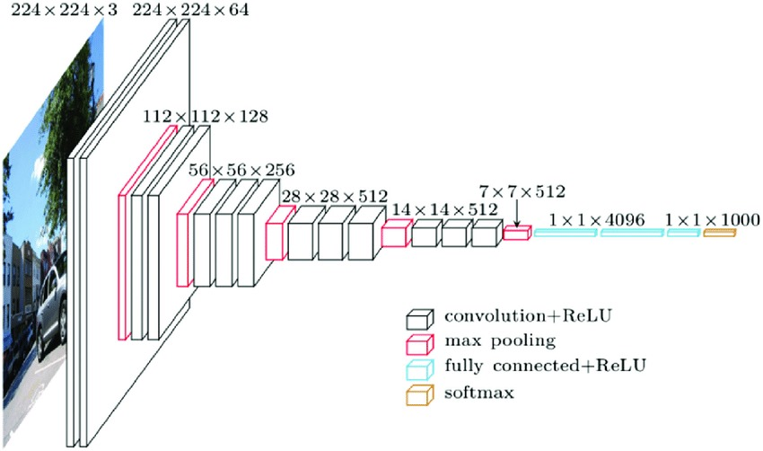
VGG-16 (cont.)
33

Slide 36
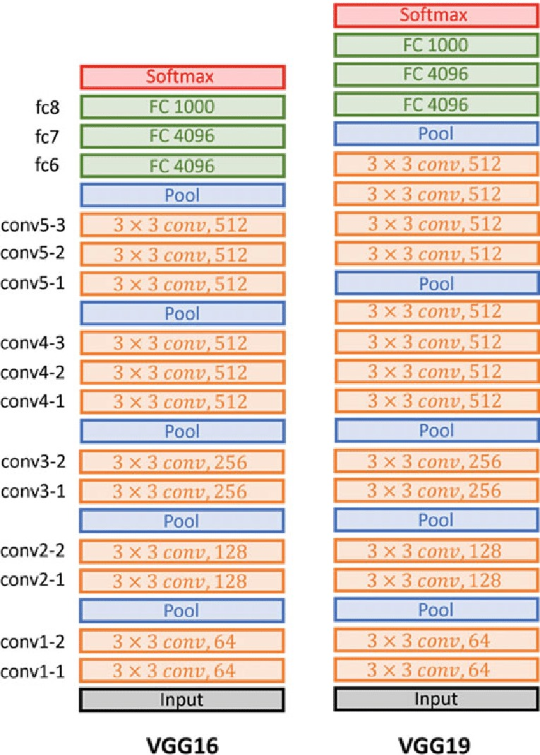
VGG-16 (cont.)
34

Slide 37
Conclusion and Furure Work
06
Simulation of lung cancer patient’s journey
Analyzing different lung data types
Prediction of lung cancer through ML algorithms
Comparing between different ML algorithms
Utilizing DL-VGG16
Classifying types of lung cancer using CT scans
Lung masks collection
Lung Segmentation
35

Slide 38

Thanks
Do you have any questions?
Nouran Moussa
Eman Elhalawany
Sara Hamouda
Nourhan Elhalawany

